Slide 1
Building solutions with SPFx that work across SharePoint and Teams

Slide 2

Building solutions with SPFx that work across SharePoint and Teams
Disclaimer : We would be talking only about the cloud world in this session .
By ,
Vignesh Ganesan – Technical Specialist , Microsoft India
Vijai Anand Ramalingam – Tech Architect , Cognizant
Global Microsoft 365 Developer Bootcamp – Bengaluru
Nov 16th , 2019

Slide 3

About Myself
Technical Specialist , Modern Workplace – Microsoft
Blogger on Vignesh’s SharePoint Thoughts , European SharePoint Community , Collab 365 , C Sharp Corner, Collab 365 & HubFly Blog site
Spoken on plethora of webinars and couple of conferences /Local User groups
Chapter Lead for C Sharp Corner Bangalore Chapter and an ambassador for aOS Community
C Sharp corner MVP /Completed 10+MS Certifications

Slide 4

My co-speaker today
Vijai Anand Ramalingam: Modern Workplace Architect , SharePoint/Office 365 – Cognizant.
Microsoft MVP/C# Corner MVP
Blogger, Author and Speaker
1200 blogs, 7 books, spoken on 4 SharePoint Saturday Events, Microsoft Ignite, Insider Dev Tour, C# Corner Webinars and Azure Vidyapeeth

Slide 5
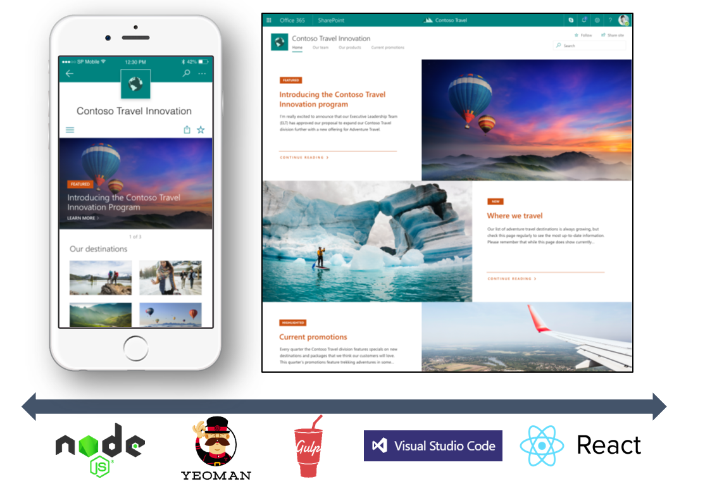
SharePoint Framework (SPFx)
Modern client-side development
Lightweight web and mobile
Powers our own experiences
Backward compatible
Supports open source tools and JavaScript web frameworks
SharePoint Framework
http://aka.ms/spfx-training
Microsoft Graph
LOB Systems and Cloud Services

Slide 6
Microsoft Graph
SharePoint Framework growth
236% usage since last year
SPFx Extension header
Web parts
Page visuals UI Fabric
11 major SPFx updates since GA
SPFx Extension footer
Notes:
2169917126 to

Slide 7
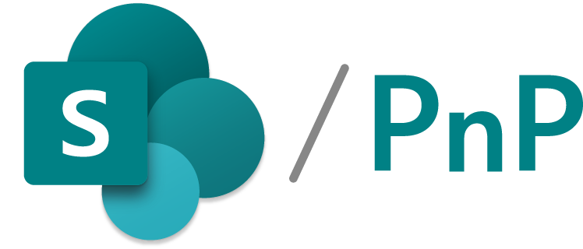
>500 samples
>1000
awarded
for helping to learn to extend Microsoft 365
Contributors in GitHub organizations
Internally at Microsoft as the reference model for community engagement
aka.ms/sppnp
>60000
>28000
>2.4 million
Visitors in GitHub organizations in past 2 weeks
Tenants using open-source components each month
Watch time minutes in the YouTube channel within last 365 days
fefe

Slide 8
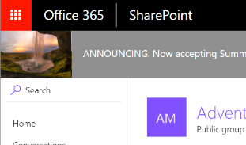
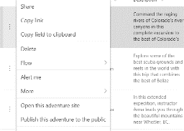
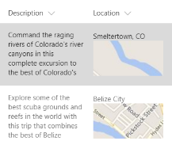
SharePoint Framework (SPFx) Extensions
Extend the user experience of SharePoint, leveraging the familiar tools and libraries for client-side development coming from the SharePoint Framework.
Application customizer
Command set
Field customizer
Add script to modern pages
Adjust top and bottom sections of page with custom renderings
Extend the modern list command surface with new actions that run custom code
Visualize data inside columns in the list view

Slide 9
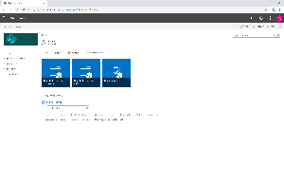
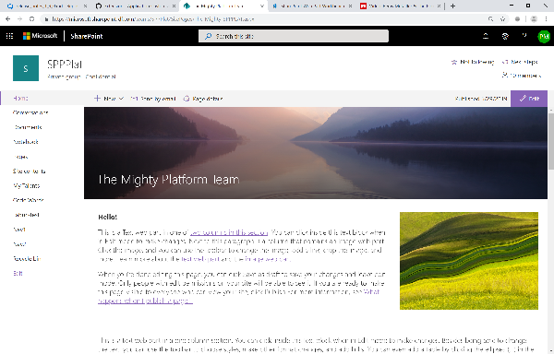
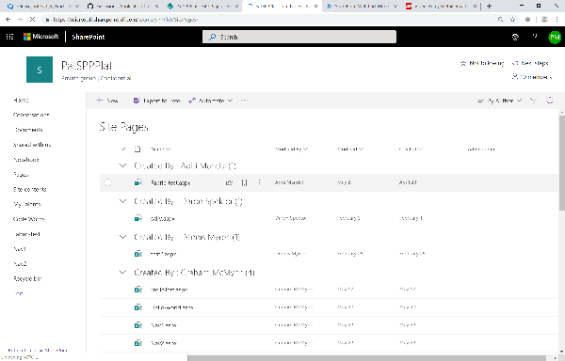
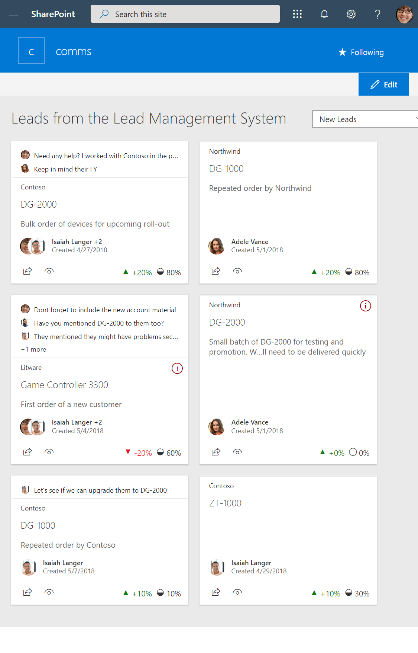
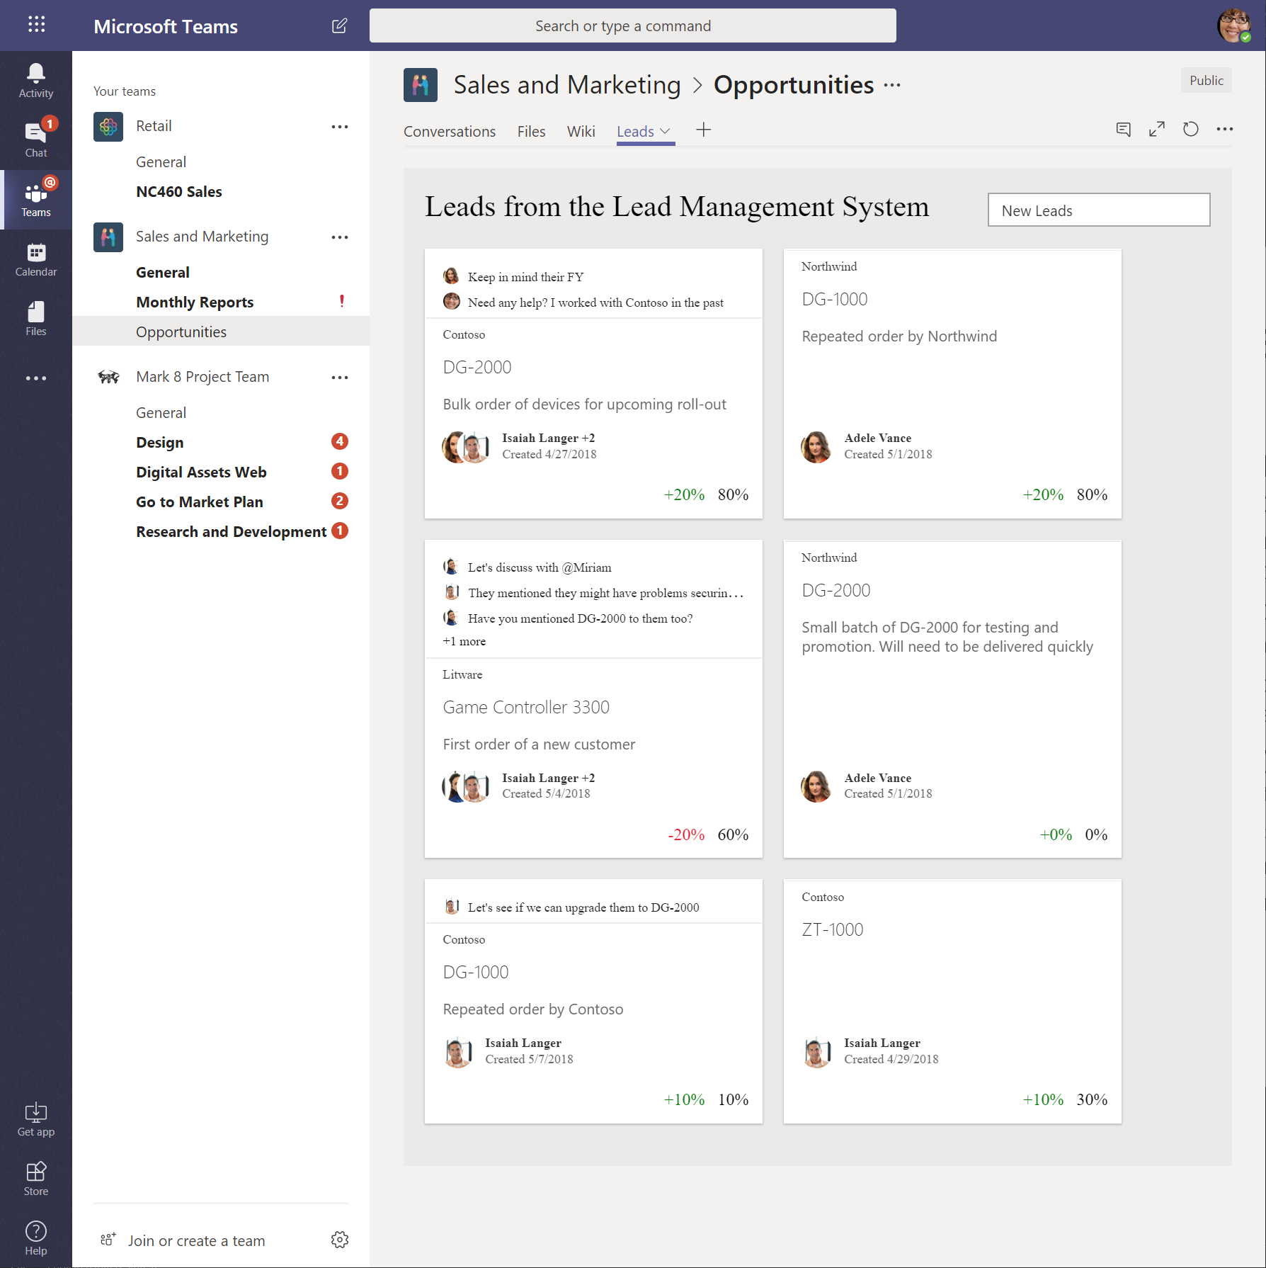
SPFx Hosted Scenarios
Classic Pages
Modern Pages
Lists and Libraries
App pages
Teams Tabs
Extensions
Extensions
Extensions
Web Parts
Web Parts
Web Parts
Web Parts

Slide 10
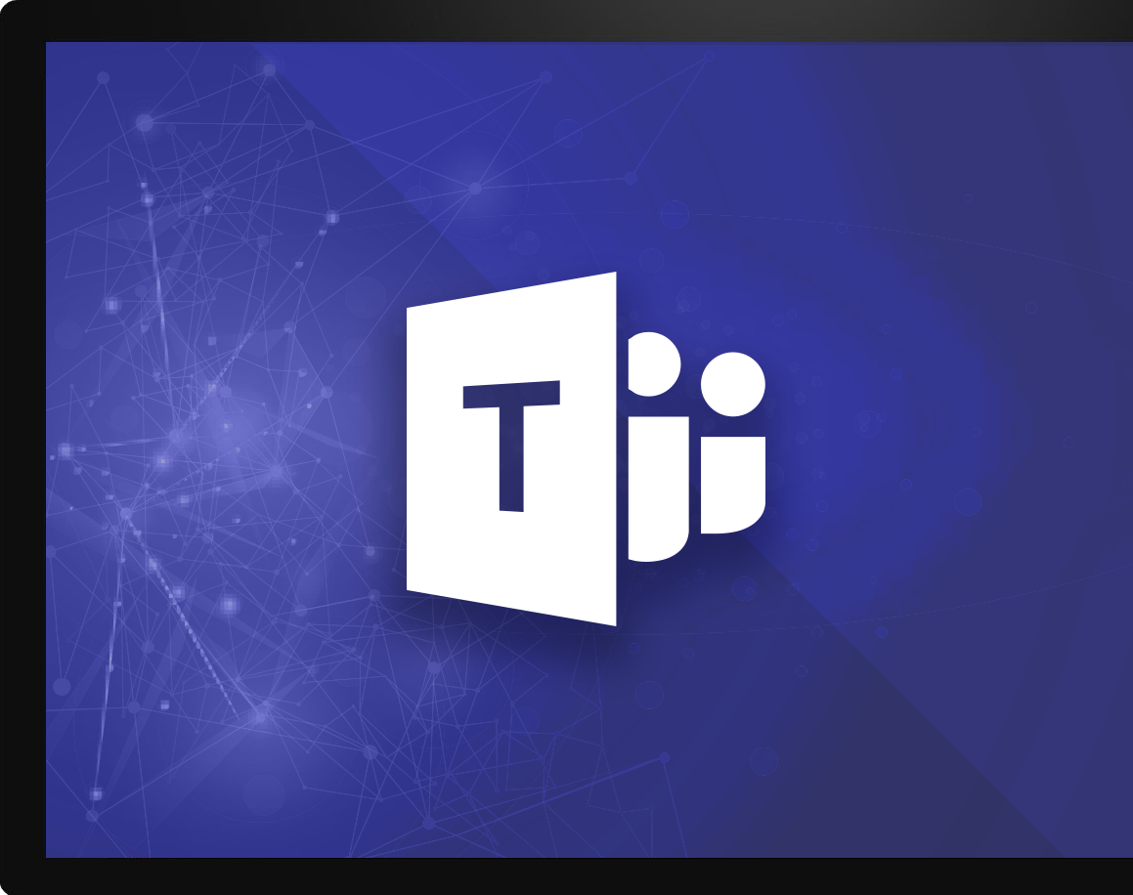
Microsoft Teams Platform
Communicate
through chat, meetings & calls
Collaborate
with deeply integrated Office 365 apps
Manage
enterprise level security, compliance, and manageability
Customize & extend
Gain context without switching context
Meet your people where they are
Tailor your teamwork
with 3rd party apps, processes, and developer tools
Notes:
Talk track: And core to that are the investments we’ve made in the Teams Platform, allowing users & developers alike to customize and build on Teams, in order to deliver experiences that your people & customers LOVE.
And when it comes to the platform and the value that our customers are seeing from it, we are seeing three distinct categories emerging:
Gain context without switching context: Teams pillar of integration (the single hub for Office) but also the ability to simply curate your experience so you reduce the information overload you get every day and focus on the content that's most relevant to you to get your job done, better. INFUSION
Meet Your people where they are: Bring together all the apps and tools your organization is already using, into one user interface. Guess what, for IT that means better & easier management, reduced security threats, and more time you can spend on valuable, forward-looking projects. For end users, #1 just got even better. (opportunity to share a 3rd party apps slide here)
Tailoring your experience: to me, this delivers superpowers to people through proactive intelligence. This is the core to the extensibility of the Teams platform. Deliver intelligent experiences using our APIs and/or our partner community that:
First: make the most difficult and time-wasting tasks at work, easy
Thereafter: drive intelligence to your people that allows them to understand how they add more value to the organization, and then deliver it more efficiently & quickly

Slide 11
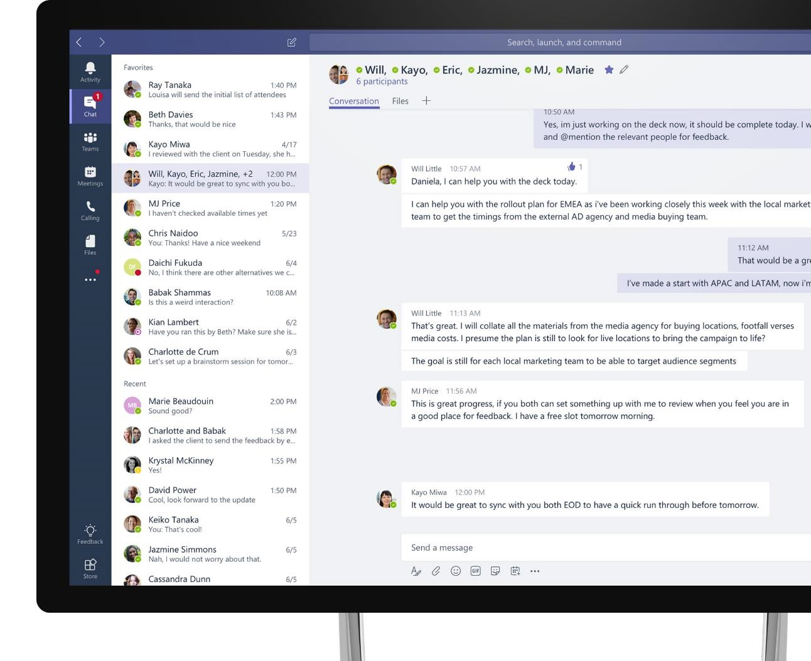
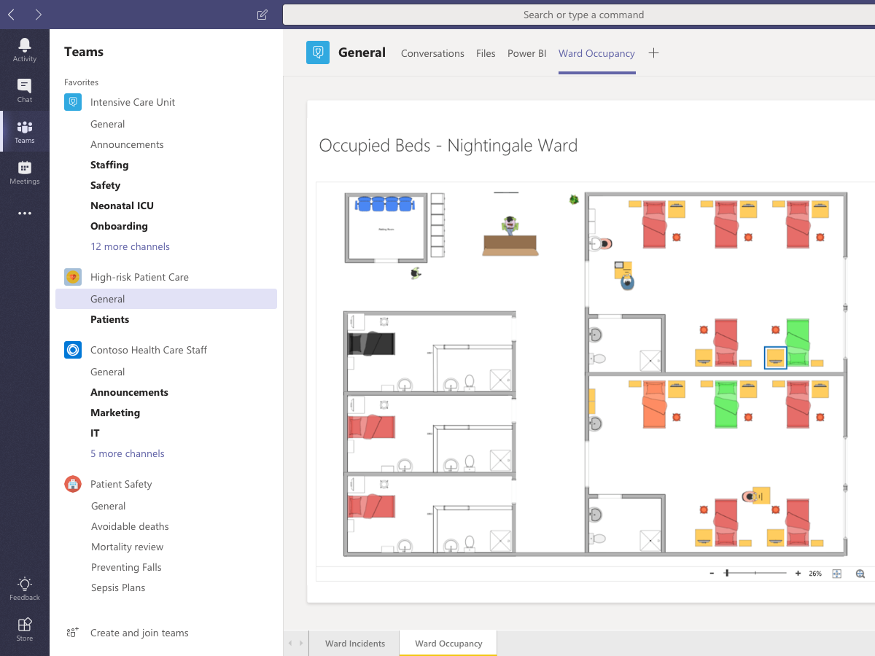




Microsoft Teams Tabs
Advantages on using SharePoint Framework as the UI implementation
Teams Solution
build with SharePoint Framework
Automated hosting
Automated hosting with optimized CDN
Easy access to Graph API
Easy Graph API access even without Azure admin UI configurations
Simple deployment
Simple centralized deployment
Reuse same implementation
One codebase to implement extensibility which works in multiple platforms
Notes:
Introduce Microsoft Teams as the problem solver. At a high level, talk about the full capabilities that Teams offers]
Microsoft Teams is a chat-based workspace where you can communicate effectively, collaborate efficiently, customize your environment and work in confidence.
[Speak through all pillars]
----------------------
[This is an animated slide. Please show it in presentation mode]
[MAIN POINT TO LAND]
And as you may already know, Microsoft Teams is the hub for teamwork, a chat-based workspace that enables teams to be more productive by giving them a single and secure location that brings together everything a team needs: chats, meetings, calls, files, and tools. Microsoft Teams is one place for all the needs your teams have.
Microsoft Teams delivers on four core promises to create a digital workspace for high performing teams.
[COMMUNICATE]
First, Microsoft Teams solves for the communication needs of a diverse workforce.
Since preview, Microsoft Teams has evolved to include a complete meetings experience, as well as chat, voice and video -
You can use Teams for informal 1:1 or group chats – directly on your phone if you’re on the go. Or you can have an open conversation in a channel. This enables people to share information in a transparent way to accelerate decision making. And it's super easy to move from a chat into a face to face meeting, helping you to bridge geographical barriers.
[COLLABORATE]
When it comes to collaboration, the deep Office integration enables today’s multigenerational workforce to use the Office apps they are familiar with and love - Word, Excel, PowerPoint, OneNote, SharePoint, Planner, even Power BI - right within the context of Teams. Teams is unique in how we enable collaboration.
Today, when you want somebody’s feedback, you send them the file via email, they store it locally with comments, you store it again…… it's a vicious cycle that results in v2, v3, v4 versions – and you have to jump between email and other apps to get the work done. Teams brings all the Office 365 services together – so that you can easily share and co-author files without the need for email attachments.
[CUSTOMIZE]
Many of you use other services than Office 365 as well which results in you having to jump between and spend time in disparate experiences. We built Teams to not only be the hub for Office 365 services, but for all the services and tools teams use on a day to day basis. So, you can customize Teams with tabs, connector and bots to include the apps and services you need - <mention relevant 3rd party apps like GitHub and Trello that can be included in Teams>– we have integrations with over 150 partners. For our developer community, we have also created an extensible platform, to enable building apps and to integrate with business processes.
[WORK WITH CONFIDENCE]
Microsoft Teams comes with the enterprise grade security, compliance and manageability that you expect from Office 365 which customers tell us is a huge value add for them.

Slide 12
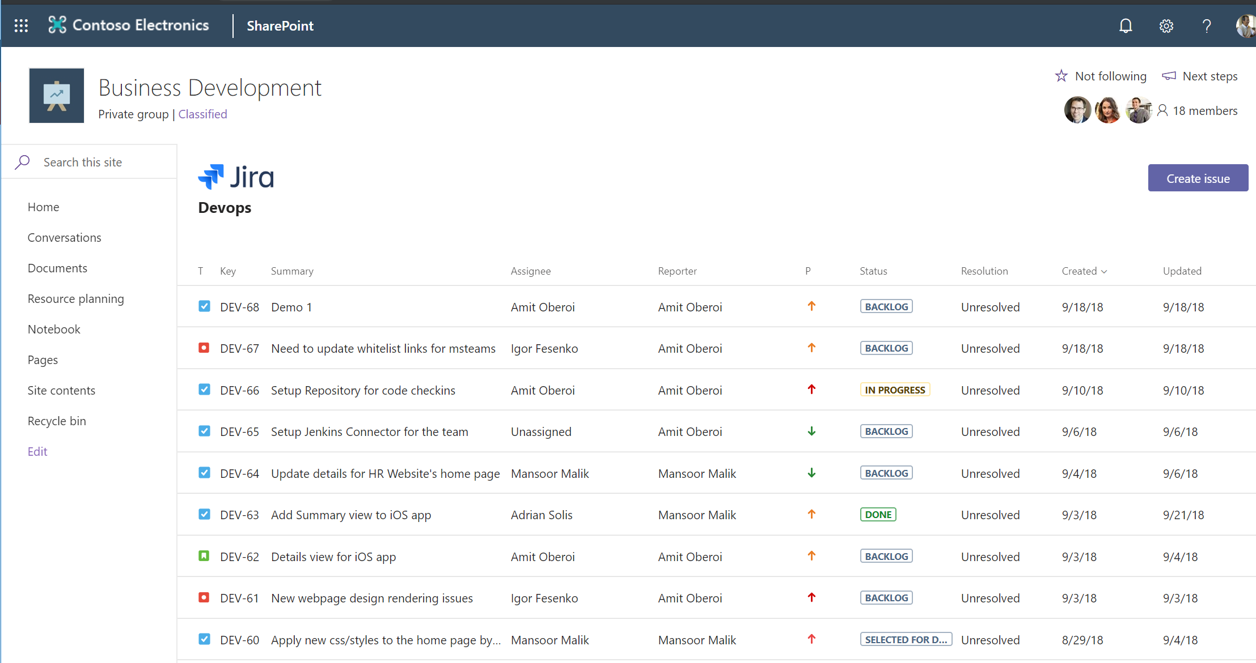
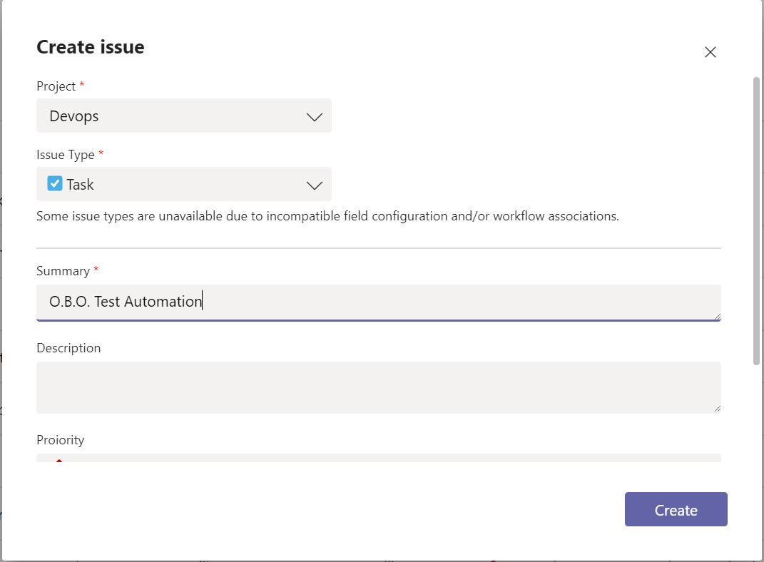
Tabs in SharePoint Pages
Uses the same infrastructure / technology as the Microsoft Teams Tab
Even same package!
Logical successor to the existing SharePoint add-In model
A common development methodology for iFramed solutions
Supports both js/client solutions as well as traditional server-side solutions (.aspx/C# or even Java)

Slide 13
Demo
Microsoft Teams extensibility build with SharePoint Framework
Notes:
- What work was involved in making your bits Teams ready? (answer, very little, making sure styling worked well and things made sense in context of teams)
- Why is being in Teams important to your customers? (answer, it’s where users are engaged and offering solutions where the users are working is great for productivity)
- What O365 dev things do you use? (answer, spfx, lots of Microsoft Graph, Teams tabs)

Slide 14




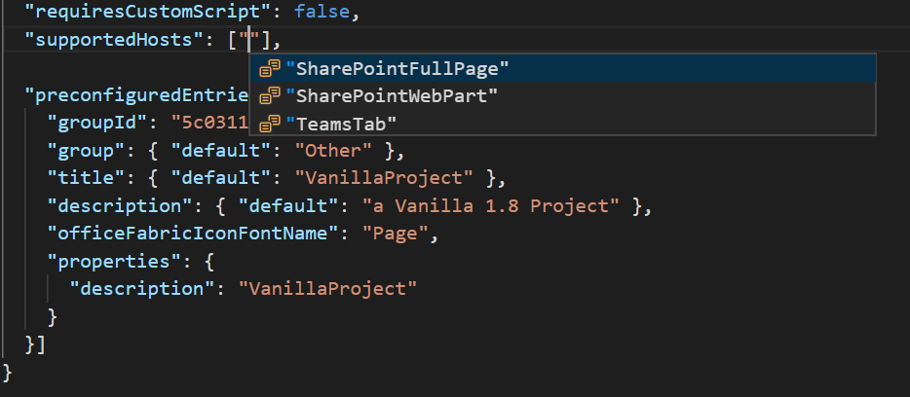
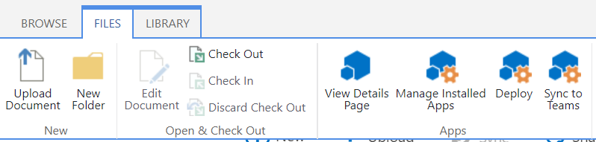
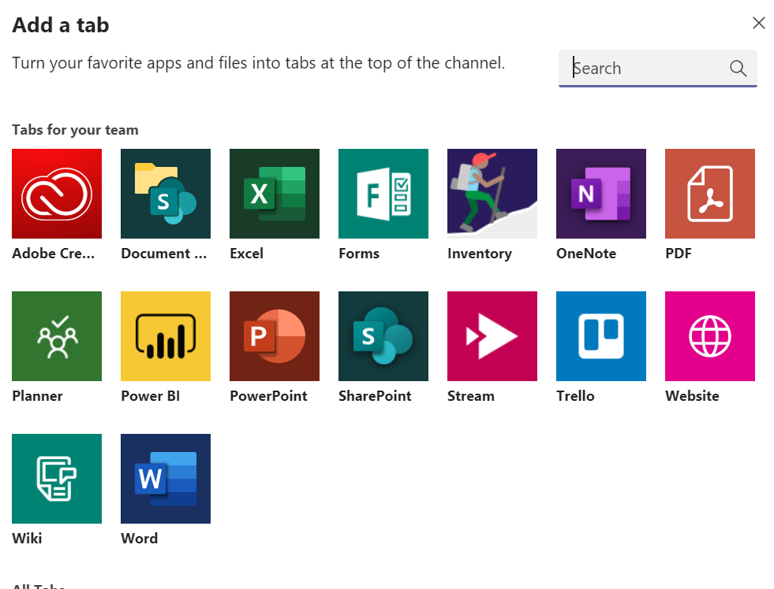
Develop Teams Tabs using SPFx
Enable developers to build SPFx based Tabs solutions
Full Teams context and SDK available at development and run time
Hosting, authentication, and API access handled by SharePoint directly
Full support for rich clients

Slide 15
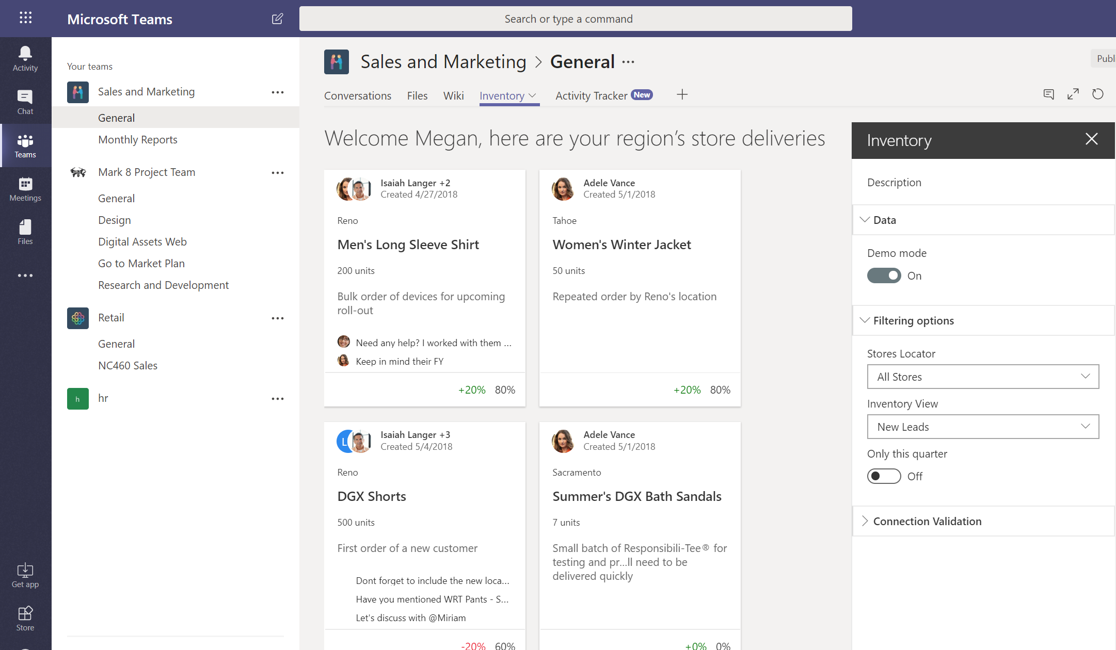
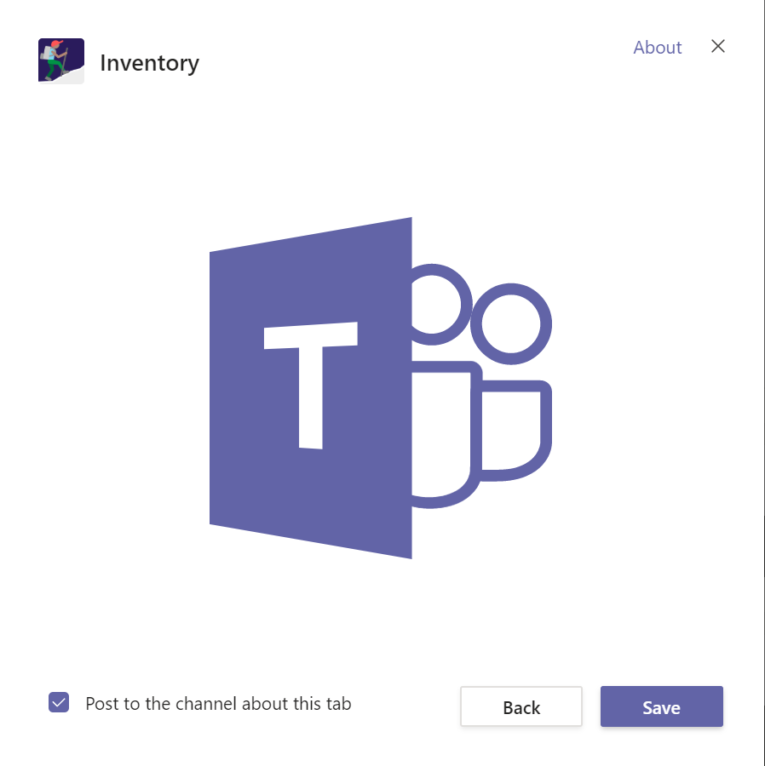
Building Tabs using SPFx Development Model
Enable developers to build SPFx based Tabs solutions
Full Teams context and SDK available at development and run time
Hosting, authentication, and API access handled by SharePoint directly
Full support for rich clients

Slide 16
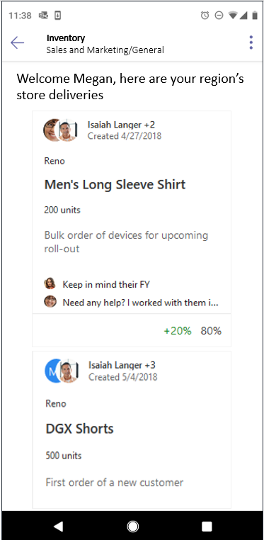
Building Tabs using SPFx Development Model
In design phase
Enable developers to build SPFx based Tabs solutions
Full Teams context and SDK available at development and run time
Hosting, authentication, and API access handled by SharePoint directly
Full support for rich clients

Slide 17
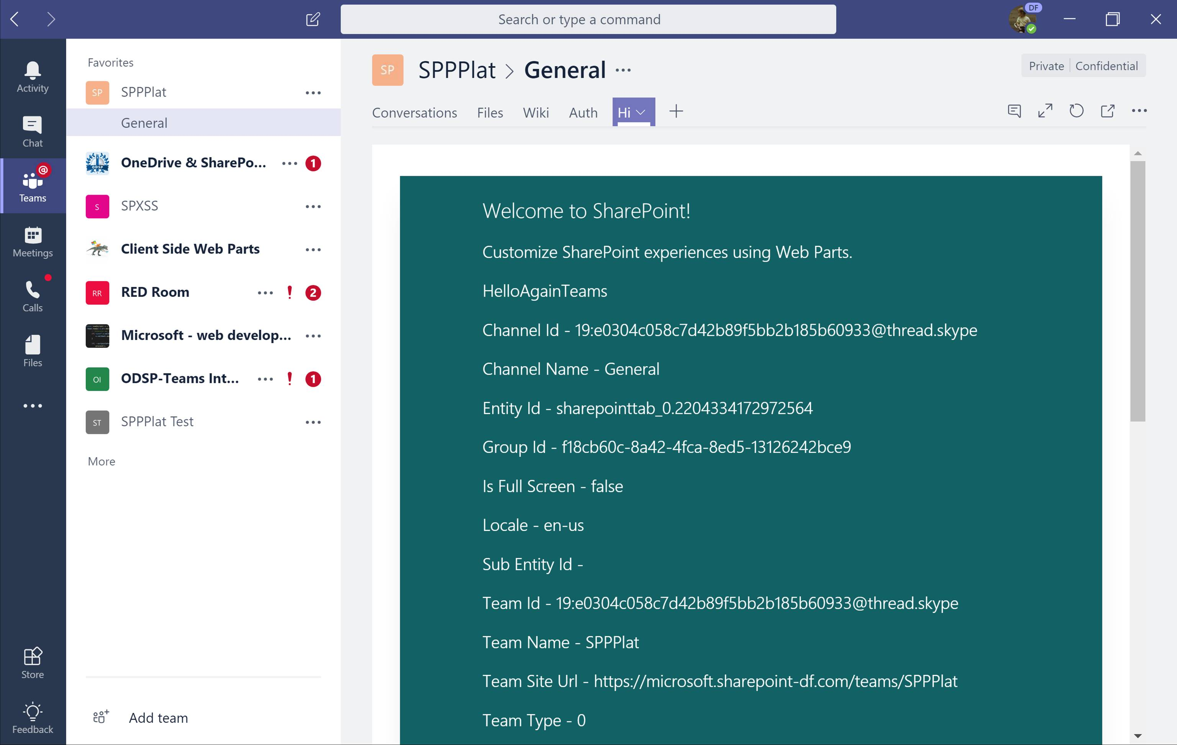
Building Tabs using SPFx Development Model
Office 365 public CDN
js
JavaScript Library
SharePoint Online
3
SPFx Teams Application
All typical configuration available as for any SPFx solution – like asset packaging, CDN configuration, asset provisioning etc.
js
SPFx solution
Tenant App catalog
SPFx Teams application exposed in the Microsoft Teams as a tab (IFrame). Assets are hosted in SharePoint and published to Teams using standard Teams model.
js
SPFx Teams solutions are deployed to Office 365 tenants using tenant app catalog- Typical options for the sppkg file packaging and hosting available.
JavaScript Library
2
1

Slide 18
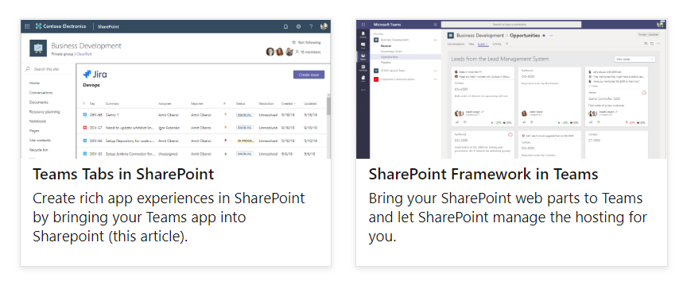
Rich integration between Teams and SharePoint
Notes:
With the November release of Teams and SharePoint Framework v. 1.7, developers have two powerful capabilities:

Slide 19
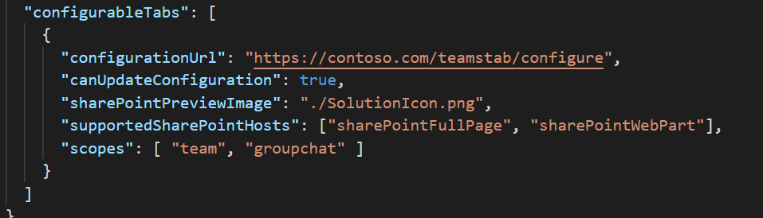
"Teams" Provider Hosted Solutions in SharePoint
Uses the same infrastructure / package as Microsoft Teams
Supported both as Web Part and App Page
Provides the SharePoint Page Context as part of the SDK
Requires minimal or no changes to existing solutions
Supports both js/client solutions as well as traditional server-side solutions (.Net / C# or even Python)

Slide 20
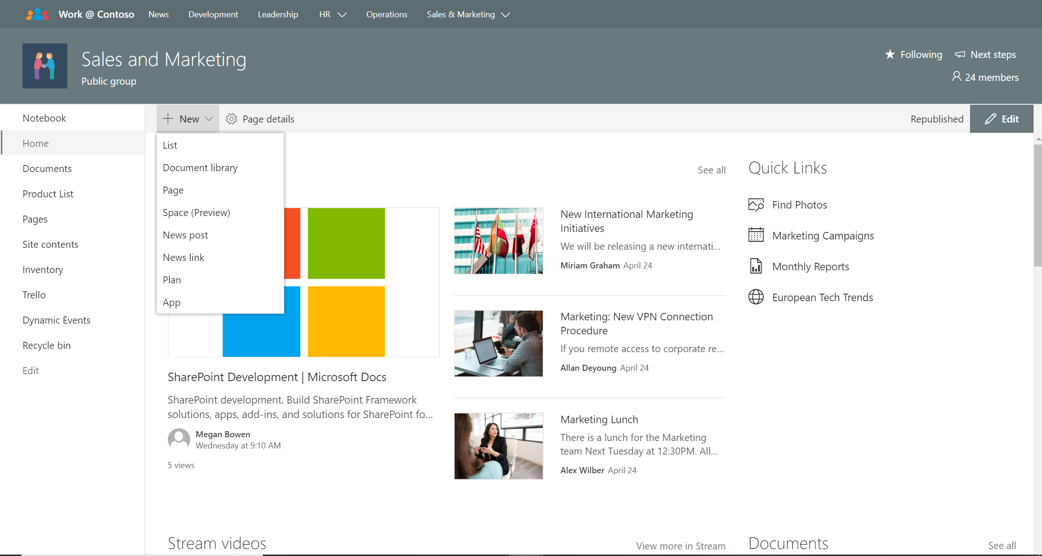
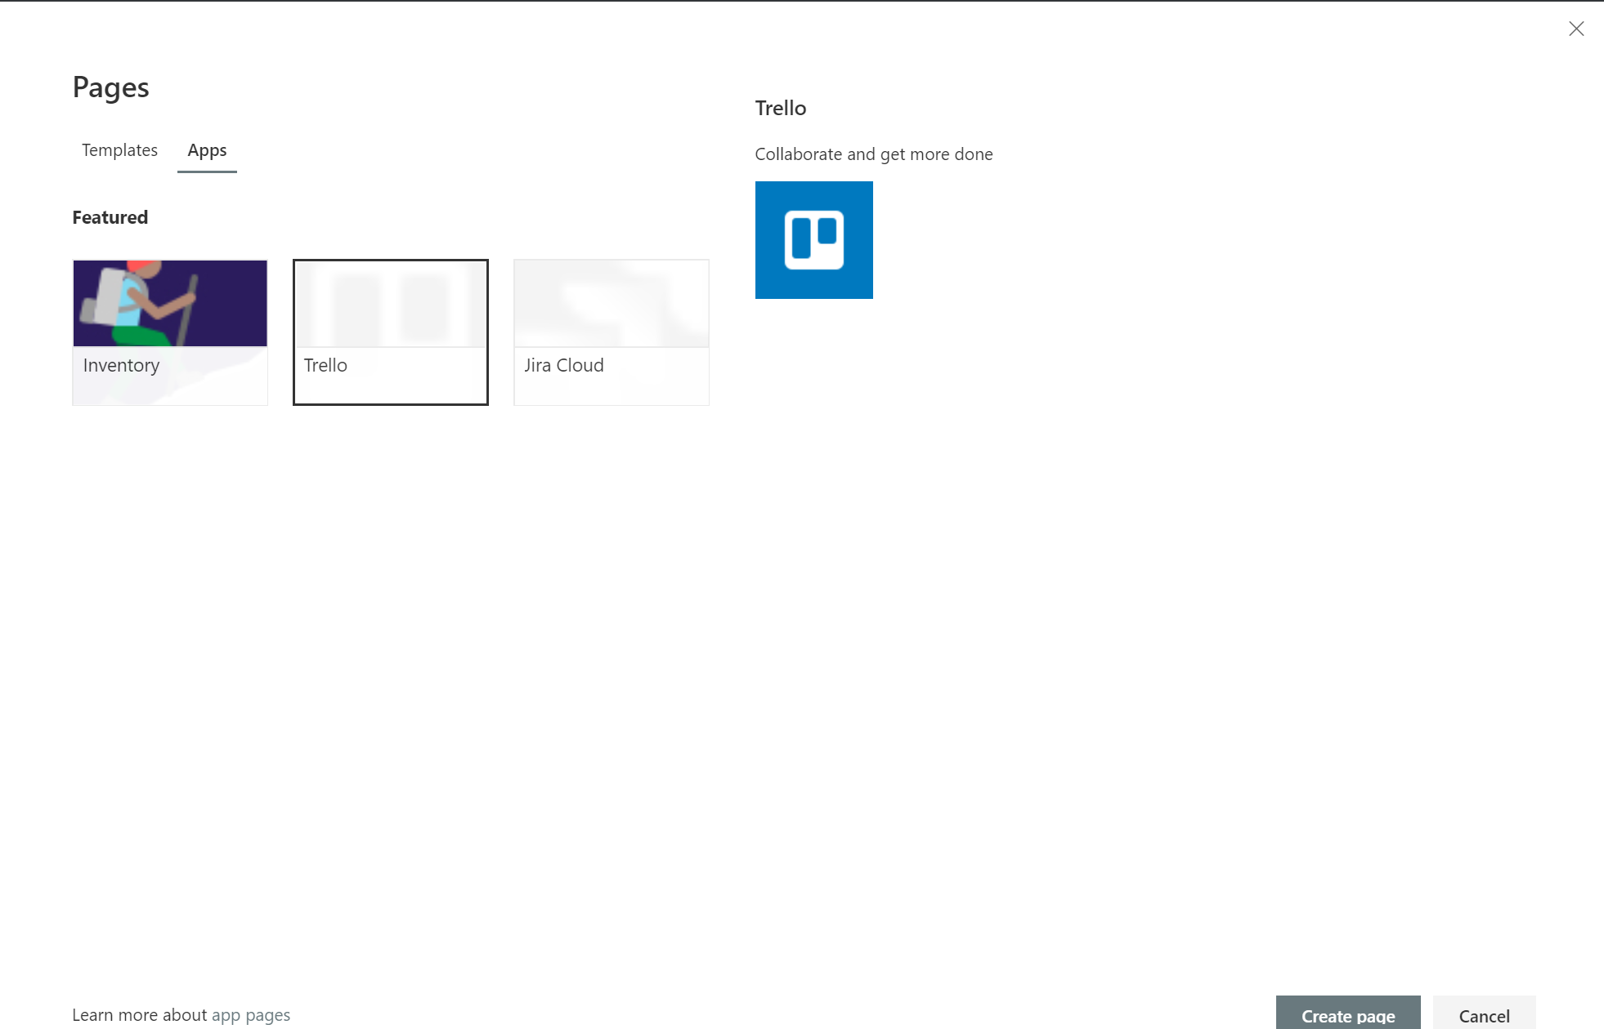

Slide 21
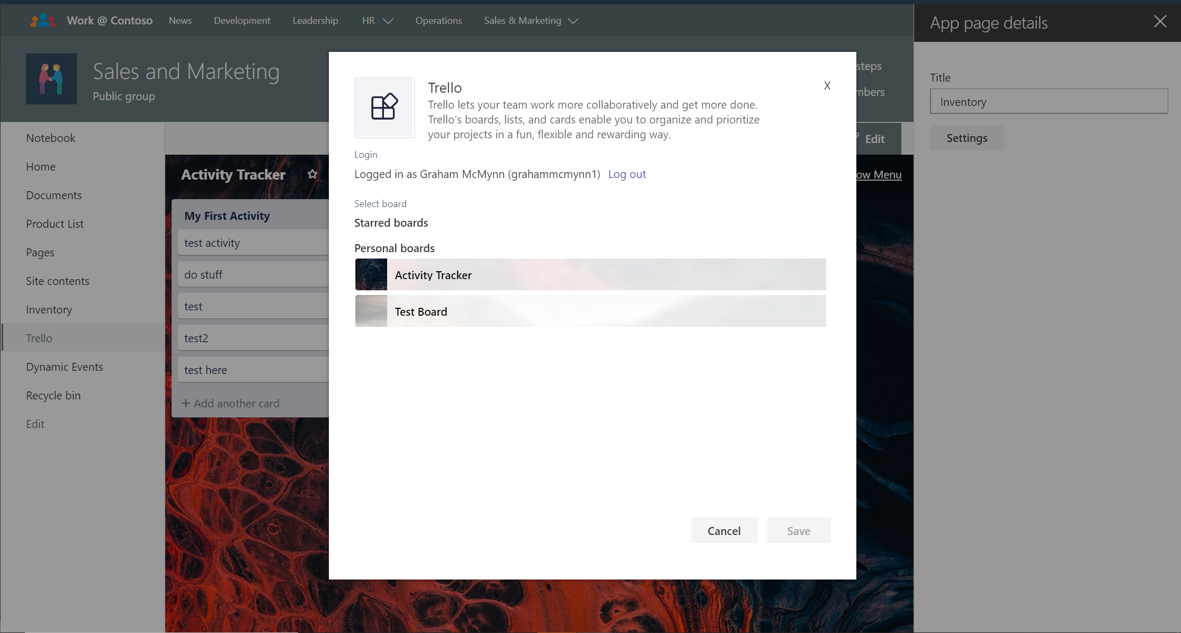

Slide 22
Tabs Development Models
Provider Hosted
SPFx
Ideal for surfacing existing solutions in multiple platforms
Works for personal and configurable tabs
Requires existing infrastructure (web APIs + rendering)
Ideal for building solution for Microsoft 365
Supports Teams, SharePoint… And more
Works for configurable tabs
Supports single sign-on on web and rich clients
Can leverage Office 365 infrastructure

Slide 23
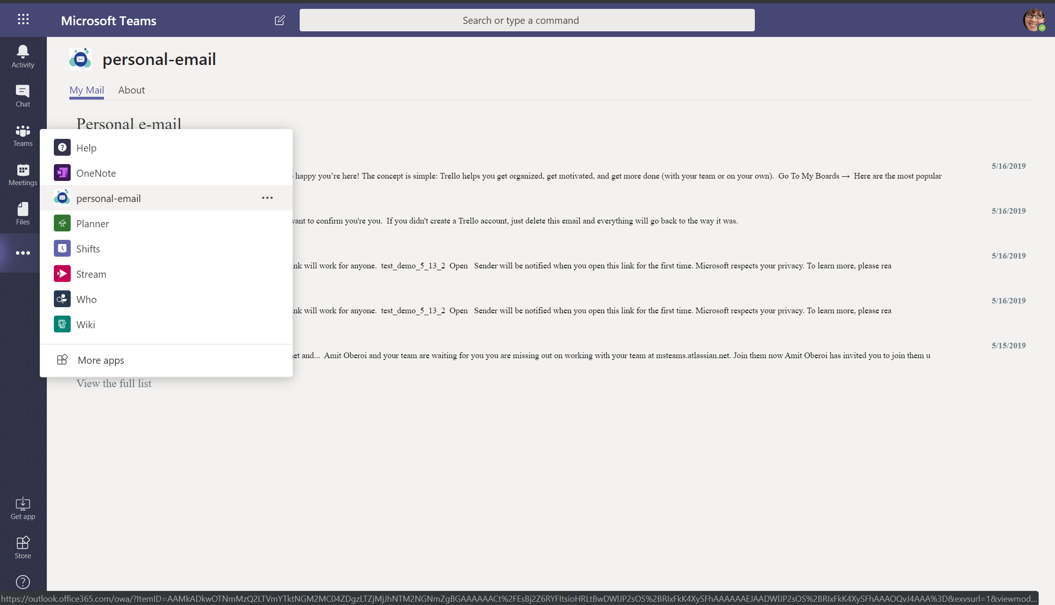
Using SPFx for building Personal tabs
In design phase
Like group chat tabs, developers target Personal tabs using supportedHost property in the manifest
Manifest in Teams gets generated automatically from SharePoint App Catalog
In Teams, they surface as staticTabs: no configuration capability is provided

Slide 24
References
https://docs.microsoft.com/en-us/sharepoint/dev/spfx/web-parts/get-started/using-web-part-as-ms-teams-tab
https://docs.microsoft.com/en-us/microsoftteams/platform/concepts/tabs/tabs-in-sharepoint

Slide 25
SharePoint Development
Getting started
1
2
3
Build SharePoint Framework extensibility
Explore Patterns and Practices open-source assets
Extend and integrate with Microsoft ecosystem
Sign up for the Office 365 Dev Program - https://aka.ms/offdp

Slide 26
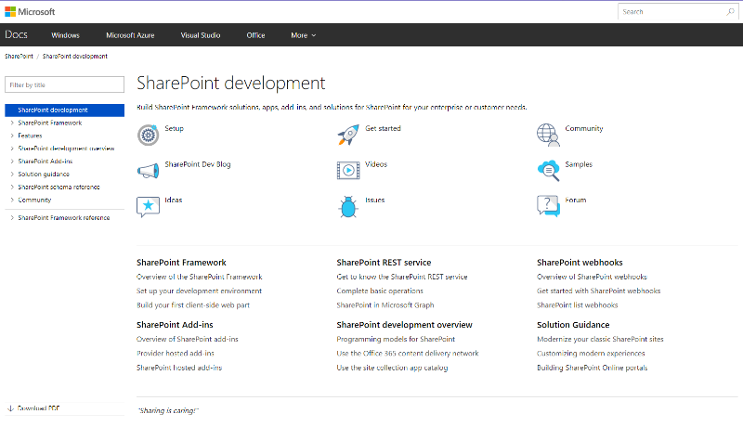
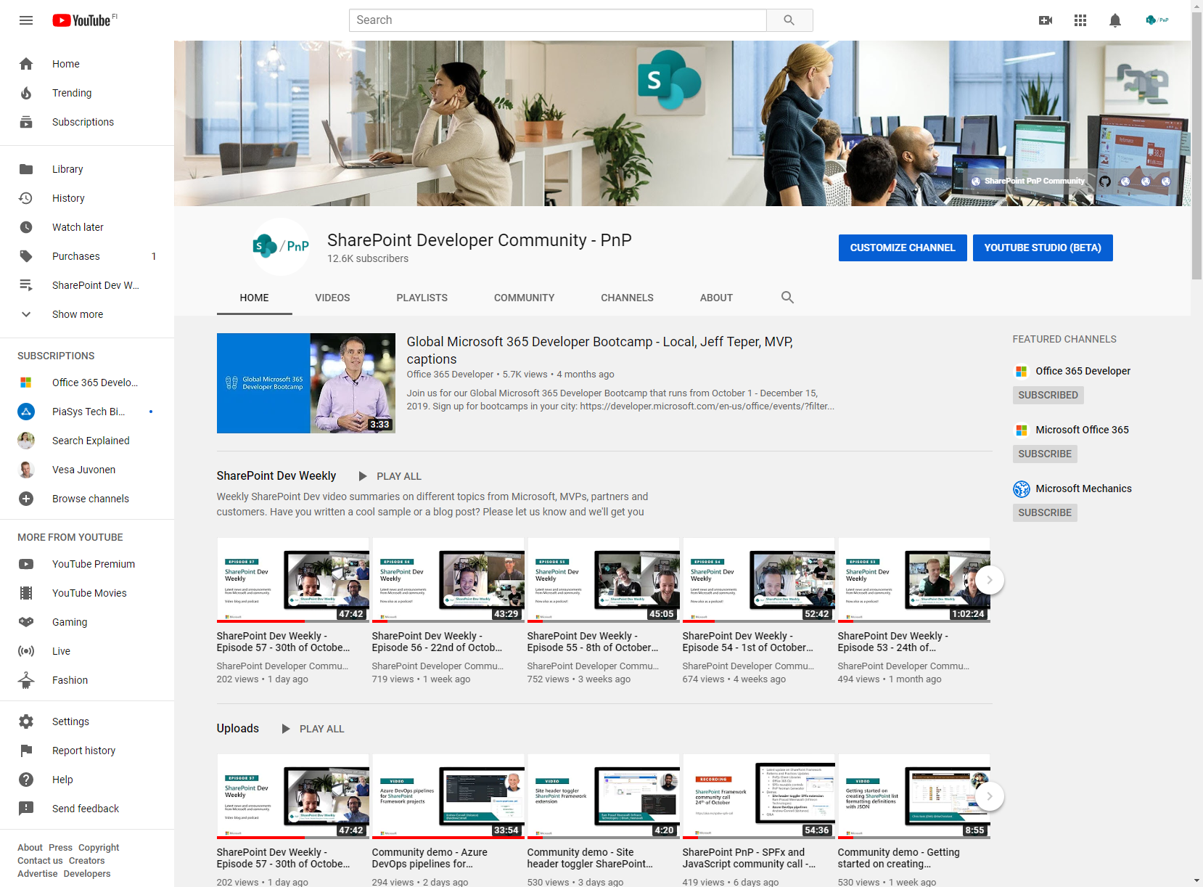
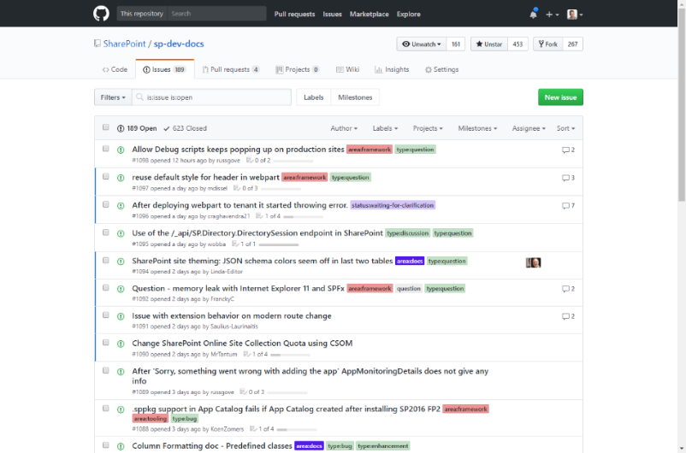
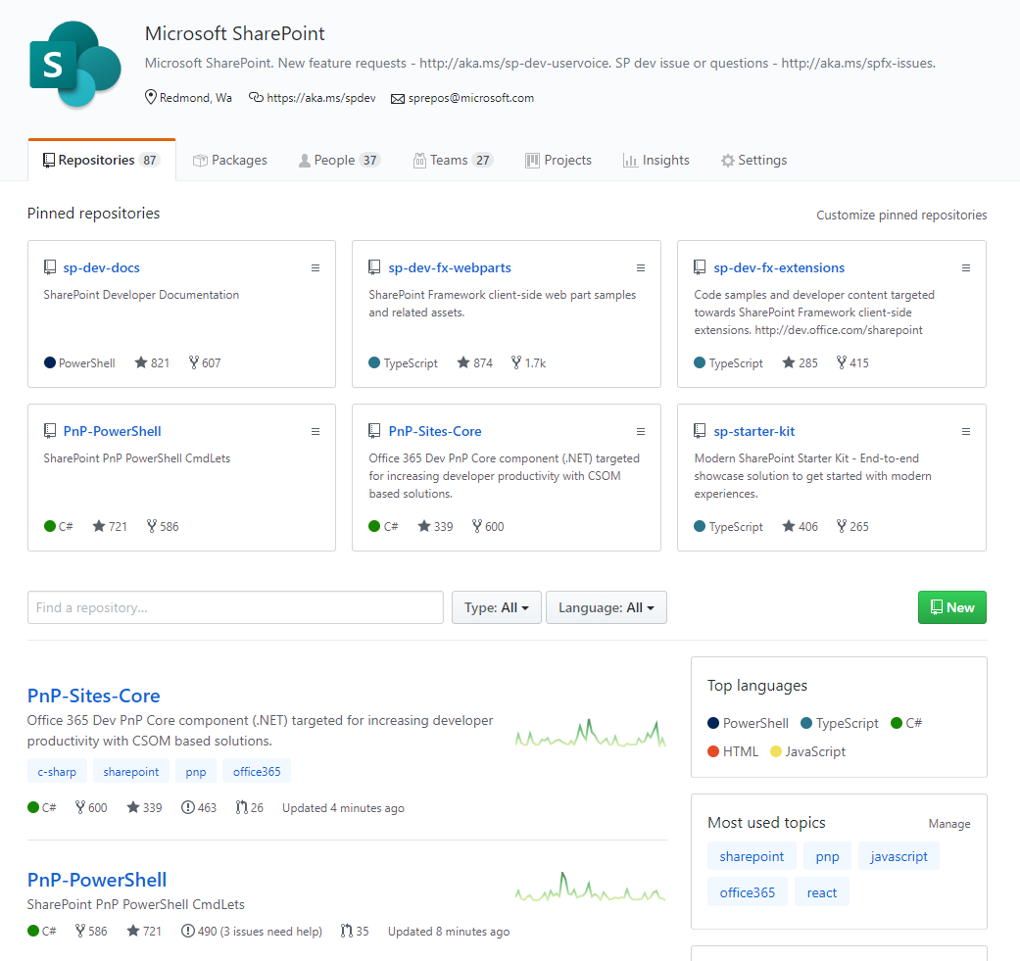
SharePoint Dev docs
SharePoint (Dev) videos
SharePoint Dev issues
Open-source
aka.ms/spdev-docs
aka.ms/spdev-videos
aka.ms/spdev-issues
github.com/sharepoint
github.com/pnp

Slide 27
All New! training, certification and tools
For Microsoft 365 developers
You can find Microsoft 365 developer training modules on Microsoft Learn!
https://aka.ms/M365DevTraining
Free for Ignite 2019 participants!
Become Microsoft 365 Certified! Earn a Developer Associate certification
Exam MS-600: Building Applications and Solutions with Microsoft 365 Core Services (beta)
Get 80% off during beta period - receive full credit!
Join the Office 365 Developer Program! Get the new Microsoft 365 E5 dev subscription, sample data packs and more great tools
https://aka.ms/IgniteO365DevProgram

Slide 28


Thank you.

Slide 29

Enjoy the Bootcamp

Slide 30

Call to action
Share your feedback on Bootcamp at https://aka.ms/Microsoft365DevBootcampSurvey2019
Join Office 365 developer program https://dev.office.com/devprogram to leverage all resources for Office 365 development learning
Build applications on Office 365 platform
Attend MVP led local community events to continue learning on Office 365 development

